Slide 1


Module 6: Co-Processor

Slide 2
Introduction to 8087 – math co-processor
01

Slide 3
Introduction
Compatible Processors and Coprocessor
Processors
1. 8086 & 8088
2. 80286
3. 80386DX
4. 80386SX
5. 80486DX
6. 80486SX
Coprocessors
1. 8087
2. 80287,80287XL
3. 80287,80387DX
4. 80387SX
6. 80487SX

Slide 4
Introduction
INTEL designed the first Math Co-Processor to perform 16 bit processes.
This was built specifically to pair and work with 8086 and 8088 microprocessors.
There would be lot of floating point calculations involved in any math process and hence to perform these efficiently, the 8087 co-processor was introduced.
Simple arithmetic operations such as addition, subtraction, multiplication and division care carried out by the 8086 processor itself and they are not the job of the advanced co-processor
The co-processor is dedicated to perform advanced scientific calculations and complex algebraic functions.

Slide 5
Introduction
If there is an extra co-processor to perform all the floating point operations, then the CPU can be free from all these chores.
This allows the CPU to focus on its other tasks that are intended to be performed by the CPU alone.
Since time and workload sharing is done among the CPU and co-processor, time consumption is reduced to a greater extend.
The 8087 co-processor has around 60 new instructions that the user can make use of.
In order to differentiate between the 8086 and 8087 instruction sets, the mnemonics begin with ‘F’.
E.g., 8087 instruction for multiplication and division are FMUL and FDIV

Slide 6
Introduction
Other names of the math co-processor 8087 are the following
Numeric Processor Extension (NPX)
Numeric Data Processor (NDP)
Floating Point Unit (FPU)

Slide 7
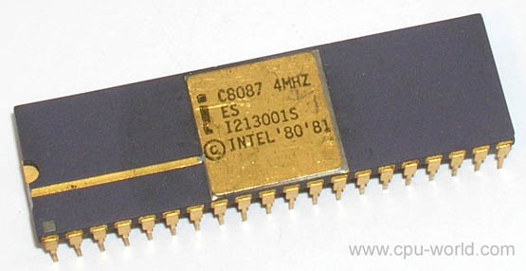
8087 Math Co-Processor 40 pin ceramic dip – Engineering Sample
Source:
http://www.cpu-world.com/CPUs/8087/MANUF-Intel.html as on 08 Jul 2020

Slide 8
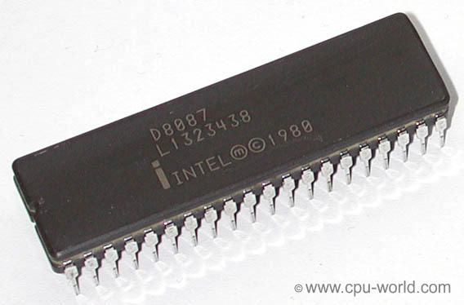
8087 Math Co-Processor 40 pin ceramic DIP
Source:
http://www.cpu-world.com/CPUs/8087/MANUF-Intel.html as on 08 Jul 2020

Slide 9
About 8087
Intel’s 8087 math co-processors are fabricated in two forms
Ceramic DIP
Hermetic DIP
The temperature ranges that the 8087 co-processors can operate are
Commercial temperature range for parts with C, D, QC and QD prefixes (0 to 70 degree).
Industrial temperature range for parts with LC, LD, TC and TD prefixes (-40⁰ Cel to +85⁰ Cel).
Military temperature range for parts with MC and MD prefixes (-55⁰ Cel to +125⁰ Cel).
The clock speed with which the co-processors work range from 4 MHz to 10 MHz

Slide 10
Weblinks
http://www.cpu-world.com/CPUs/8087/MANUF-Intel.html
http://www.idc-online.com/technical_references/pdfs/electronic_engineering/8087_Co_Processors_and_Architechture.pdf

